Slide 1
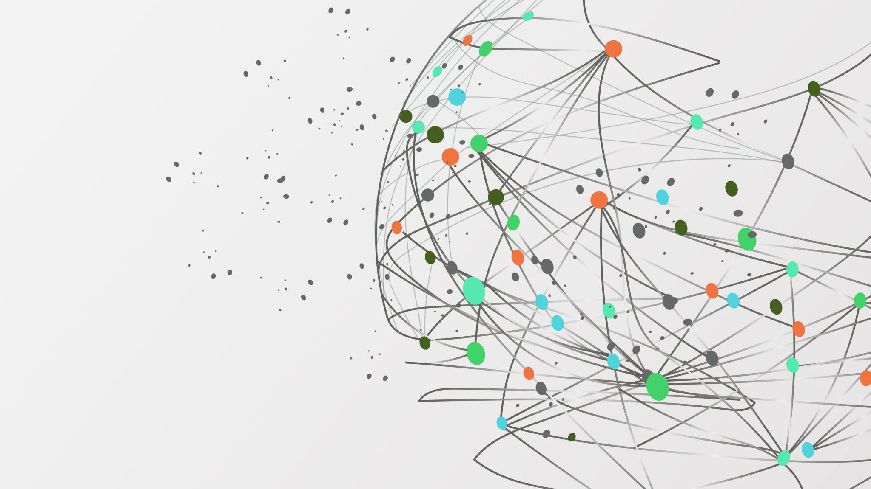
Introduction to NLP

Slide 2

What is NLP
•Branch of AI
•2 Goals
•Science Goal: Understand the way language operates
•Engineering Goal: Build systems that analyze
and generate language; reduce the man machine gap

Slide 3

What is NLP? Definitions and Applications
Definition
NLP is a branch of artificial intelligence (AI) focused on enabling computers to process and understand human language. It involves analyzing, interpreting, and generating text and speech data.
Applications
NLP has a wide range of applications, including machine translation, sentiment analysis, chatbot development, text summarization, and voice assistants.

Slide 4
Challenges in NLP
Ambiguity
A word or phrase can have multiple meanings, making it difficult for computers to understand the intended interpretation.
Complexity
Human language is incredibly complex, with numerous rules, exceptions, and nuances that make it challenging to model.
Context
Complexity Human language is incredibly complex, with numerous rules, exceptions, and nuances that make it challenging to model. The meaning of a word or sentence often depends on the surrounding text and the situation in which it is used.

Slide 5
Natural Language Processing (NLP) Working
Data preprocessing
Stemming and lemmatization
Sentence segmentation
Stop word removal
Tokenization
Feature extraction
Bag-of-Words
TF-IDF
Word2Vec
GLoVE
Modeling
Machine Learning Models
Deep neural networks
Language Models

Slide 6

Data Preprocessing
Before a model processes text for a specific task, the text often needs to be preprocessed to improve model performance or to turn words and characters into a format the model can understand. Data-centric AI is a growing movement that prioritizes data preprocessing. Various techniques may be used in this data preprocessing:
Stemming and lemmatization
Sentence segmentation
Stop word removal
Tokenization

Slide 7
Stemming and Lemmatization
Stemming is an informal process of converting words to their base forms using heuristic rules. For example, “university,” “universities,” and “university’s” might all be mapped to the base univers. (One limitation in this approach is that “universe” may also be mapped to univers, even though universe and university don’t have a close semantic relationship.) Lemmatization is a more formal way to find roots by analyzing a word’s morphology using vocabulary from a dictionary. Stemming and lemmatization are provided by libraries like spaCy and NLTK.

Slide 8
Sentence Segmentation
Sentence segmentation breaks a large piece of text into linguistically meaningful sentence units. This is obvious in languages like English, where the end of a sentence is marked by a period, but it is still not trivial. A period can be used to mark an abbreviation as well as to terminate a sentence, and in this case, the period should be part of the abbreviation token itself. The process becomes even more complex in languages, such as ancient Chinese, that don’t have a delimiter that marks the end of a sentence.

Slide 9
Stop Word Removal
Stop word removal aims to remove the most commonly occurring words that don’t add much information to the text. For example, “the,” “a,” “an,” and so on.

Slide 10
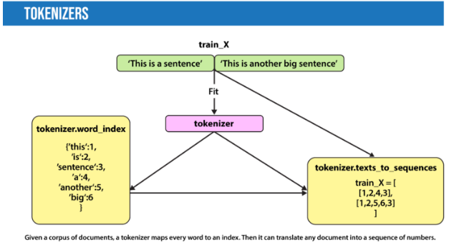
Tokenization
Tokenization splits text into individual words and word fragments. The result generally consists of a word index and tokenized text in which words may be represented as numerical tokens for use in various deep learning methods. A method that instructs language models to ignore unimportant tokens can improve efficiency.
Given a corpus of documents, a tokenizer maps every word to an index. Then it can translate any document into a sequence of numbers.

Slide 11
Feature extraction
Most conventional machine-learning techniques work on the features – generally numbers that describe a document in relation to the corpus that contains it – created by either Bag-of-Words, TF-IDF, or generic feature engineering such as document length, word polarity, and metadata (for instance, if the text has associated tags or scores). More recent techniques include Word2Vec, GLoVE, and learning the features during the training process of a neural network. There we discuss all 4;
Bag-of-Words
TF-IDF
Word2Vec
GLoVE

Slide 12
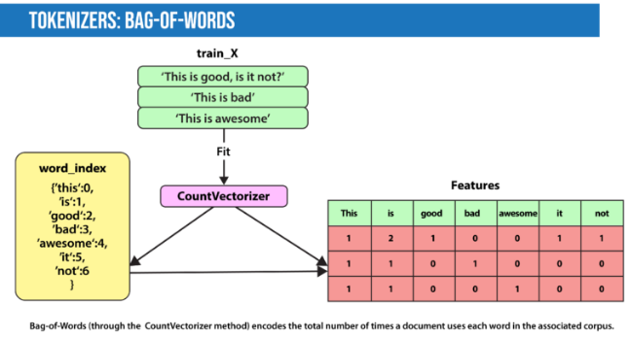
Bag-of-Words
Bag-of-Words counts the number of times each word or n-gram (combination of n words) appears in a document. For example, below, the Bag-of-Words model creates a numerical representation of the dataset based on how many of each word in the word_index occur in the document.

Slide 13

TF-IDF
In Bag-of-Words, we count the occurrence of each word or n-gram in a document. In contrast, with TF-IDF, we weight each word by its importance. To evaluate a word’s significance, we consider two things:
Term Frequency: How important is the word in the document?
TF(word in a document)= Number of occurrences of that word in document / Number of words in document
Inverse Document Frequency: How important is the term in the whole corpus?
IDF(word in a corpus)=log(number of documents in the corpus / number of documents that include the word)
A word is important if it occurs many times in a document. But that creates a problem. Words like “a” and “the” appear often. And as such, their TF score will always be high. We resolve this issue by using Inverse Document Frequency, which is high if the word is rare and low if the word is common across the corpus. The TF-IDF score of a term is the product of TF and IDF.

Slide 14
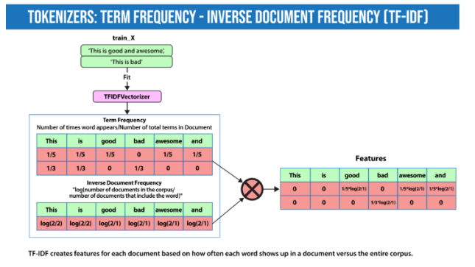

Slide 15

Word2Vec
Word2Vec, introduced in 2013, uses a vanilla neural network to learn high-dimensional word embeddings from raw text. It comes in two variations: Skip-Gram, in which we try to predict surrounding words given a target word, and Continuous Bag-of-Words (CBOW), which tries to predict the target word from surrounding words. After discarding the final layer after training, these models take a word as input and output a word embedding that can be used as an input to many NLP tasks. Embeddings from Word2Vec capture context. If particular words appear in similar contexts, their embeddings will be similar.

Slide 16

GLoVE
GLoVE is similar to Word2Vec as it also learns word embeddings, but it does so by using matrix factorization techniques rather than neural learning. The GLoVE model builds a matrix based on the global word-to-word co-occurrence counts.

Slide 17

Modeling
After data is preprocessed, it is fed into an NLP architecture that models the data to accomplish a variety of tasks.
Machine Learning Models
Deep neural networks
Language Models

Slide 18

Traditional Machine learning NLP techniques
Logistic Regression
is a supervised classification algorithm that aims to predict the probability that an event will occur based on some input. In NLP, logistic regression models can be applied to solve problems such as sentiment analysis, spam detection, and toxicity classification.
Decision Trees
are a class of supervised classification models that split the dataset based on different features to maximize information gain in those splits.

Slide 19
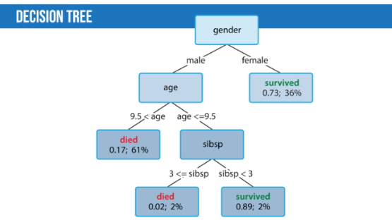
This decision tree assesses the survival of males and females aboard the Titanic when the ship sank. "Sibsp" stands for the number of siblings and spouses. The numbers of each leaf of the tree show first the probability of survival and second the percentage of examples classified by each leaf. Females had a 73 percent chance of survival, and young males with less than three siblings had a 89 percent chance of survival.

Slide 20
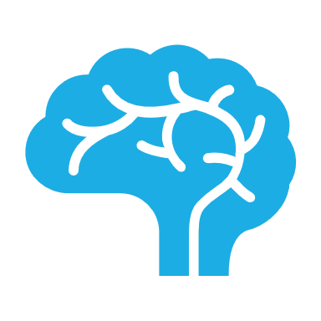
Deep learning NLP Techniques
Convolutional Neural Network (CNN): The idea of using a CNN to classify text was first presented in the paper “Convolutional Neural Networks for Sentence Classification” by Yoon Kim. The central intuition is to see a document as an image. However, instead of pixels, the input is sentences or documents represented as a matrix of words.

Slide 21
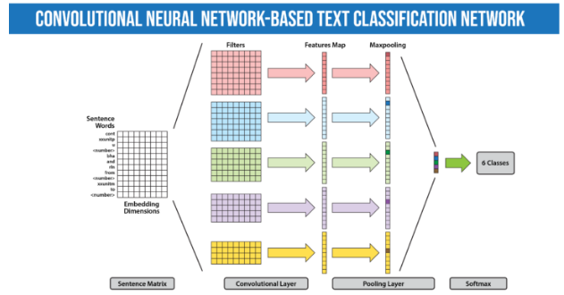
Given a sentence, a convolutional neural network uses convolutional layers to refine representations of input words. before combining them to render a classification.

Slide 22
Deep learning NLP Techniques
Recurrent Neural Network (RNN): Many techniques for text classification that use deep learning process words in close proximity using n-grams or a window (CNNs). They can see “New York” as a single instance. However, they can’t capture the context provided by a particular text sequence. They don’t learn the sequential structure of the data, where every word is dependent on the previous word or a word in the previous sentence. RNNs remember previous information using hidden states and connect it to the current task. The architectures known as Gated Recurrent Unit (GRU) and long short-term memory (LSTM) are types of RNNs designed to remember information for an extended period. Moreover, the bidirectional LSTM/GRU keeps contextual information in both directions, which is helpful in text classification. RNNs have also been used to generate mathematical proofs and translate human thoughts into words.

Slide 23
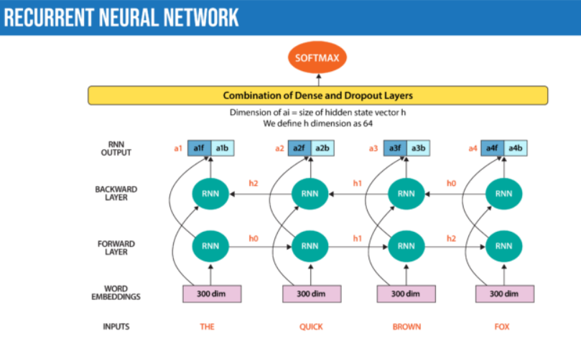
A bidirectional recurrent neural network processes the input both forward and backward to improve the representations it produces.

Slide 24

Language Models
In very basic terms, the objective of a language model is to predict the next word when given a stream of input words.
Deep learning is also used to create such language models. Deep-learning models take as input a word embedding and, at each time state, return the probability distribution of the next word as the probability for every word in the dictionary. Pre-trained language models learn the structure of a particular language by processing a large corpus, such as Wikipedia. They can then be fine-tuned for a particular task. For instance, BERT has been fine-tuned for tasks ranging from fact-checking to writing headlines.

Slide 25
Transformers
The transformer, a model architecture first described in the 2017 paper “Attention Is All You Need” (Vaswani, Shazeer, Parmar, et al.), forgoes recurrence and instead relies entirely on a self-attention mechanism to draw global dependencies between input and output. Since this mechanism processes all words at once (instead of one at a time) that decreases training speed and inference cost compared to RNNs, especially since it is parallelizable. The transformer architecture has revolutionized NLP in recent years, leading to models including BLOOM, Jurassic-X, and Turing-NLG. It has also been successfully applied to a variety of different vision tasks, including making 3D images.

Slide 26
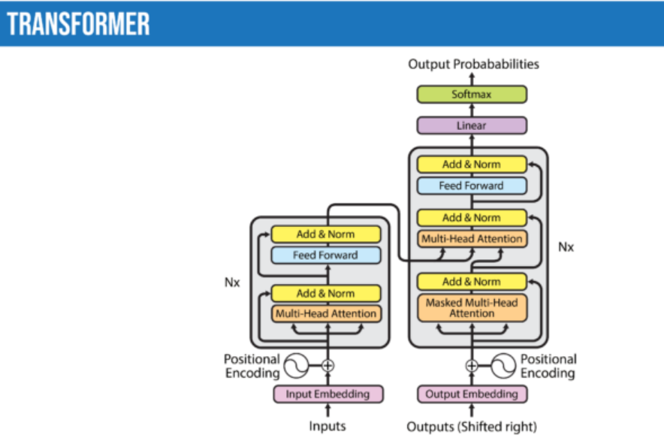
The encoder-decoder transformer used for translation. Encoder on the left, decoder on the right. Note that the decoder takes in its previously generated words during generation.

Slide 27
Tools For Natural Language Processing (NLP)
Programming Languages
Python
R
Libraries & Frameworks
Natural Language Toolkit (NLTK)
spaCy
TensorFlow
PyTorch
Hugging Face

Slide 28

Python
is the most-used programming language to tackle NLP tasks. Most libraries and frameworks for deep learning are written for Python. Here are a few that practitioners may find helpful:
Natural Language Toolkit (NLTK) is one of the first NLP libraries written in Python. It provides easy-to-use interfaces to corpora and lexical resources such as WordNet. It also provides a suite of text-processing libraries for classification, tagging, stemming, parsing, and semantic reasoning.
spaCy is one of the most versatile open source NLP libraries. It supports more than 66 languages. spaCy also provides pre-trained word vectors and implements many popular models like BERT. spaCy can be used for building production-ready systems for named entity recognition, part-of-speech tagging, dependency parsing, sentence segmentation, text classification, lemmatization, morphological analysis, entity linking, and so on.

Slide 29

R
Many early NLP models were written in R, and R is still widely used by data scientists and statisticians. Libraries in R for NLP include TidyText, Weka, Word2Vec, SpaCyR, TensorFlow, and PyTorch.

